Slide 1
Digital Image Processing CSC331
Image Segmentation

Slide 2
Summery of previous lecture
Segmentation Algorithms
Discontinuity based segmentation
points, lines and edges
Link the edge points
Local processing
Global processing (Hough transformation)

Slide 3
Todays lecture
Image Segmentation by thresholding
Global threshold
Adaptive/Dynamic threshold
Local threshold

Slide 4
Segmentation Algorithms
Segmentation algorithms are based on one of two basic properties of color, gray values, or texture:
Discontinuity
Partition an image based on abrupt changes in intensity, Isolated points, lines and edges.
Differences are sudden changes (discontinuities) in any of these, but especially sudden changes in intensity along a boundary line, which is called an edge.
Similarity
Partitioning an image into regions that are similar according to a predefined criteria. Thresholding, Region growing and region splitting and merging.
Similarity may be due to pixel intensity, color or texture.

Slide 5
Segmentation by thresholding
Thresholding is the simplest method of image segmentation.
The basic thresholding methods replace each pixel in an image with a black pixel if the image intensity is less than some fixed constant T, or a white pixel if the image intensity is greater than that constant.

Slide 6
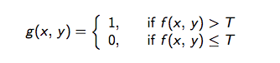

Slide 7
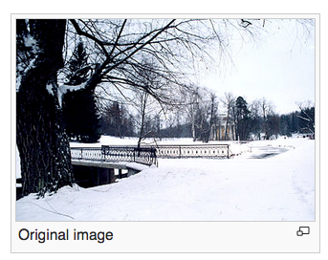
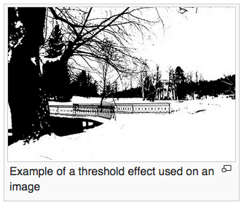

Slide 8
How to get the intensity values ?
The best way is by taking the histogram of the image.

Slide 9
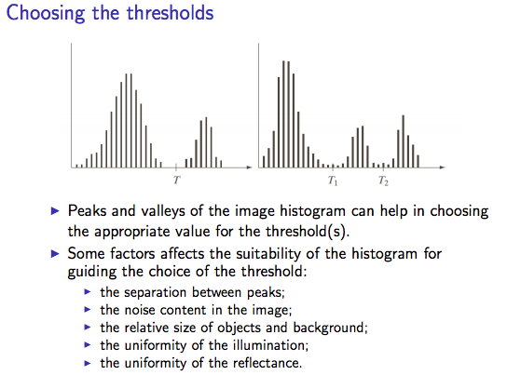
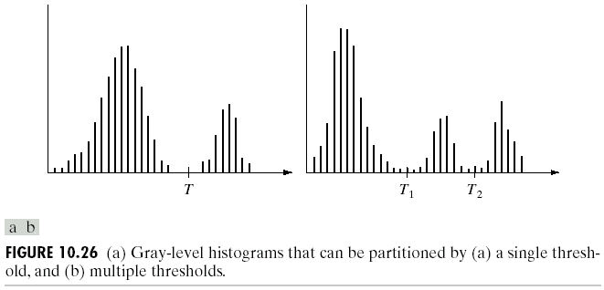
Single threshold
Multiple threshold

Slide 10
Thresholding

Slide 11
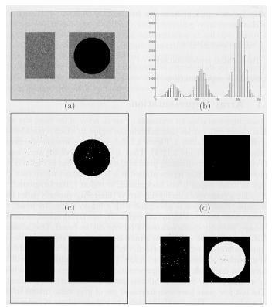
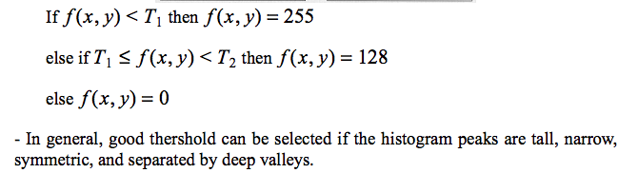
Multilevel thresholding is possible (although more difficult in practice)

Slide 12
Types of thresholds
Global threshold
Adaptive/Dynamic threshold
Local threshold

Slide 13
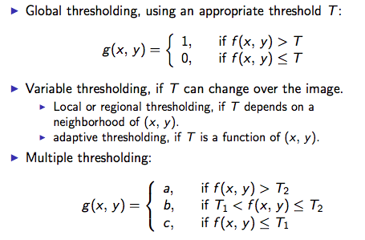

Slide 14
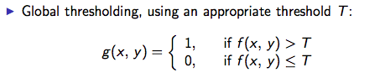
Global threshold

Slide 15
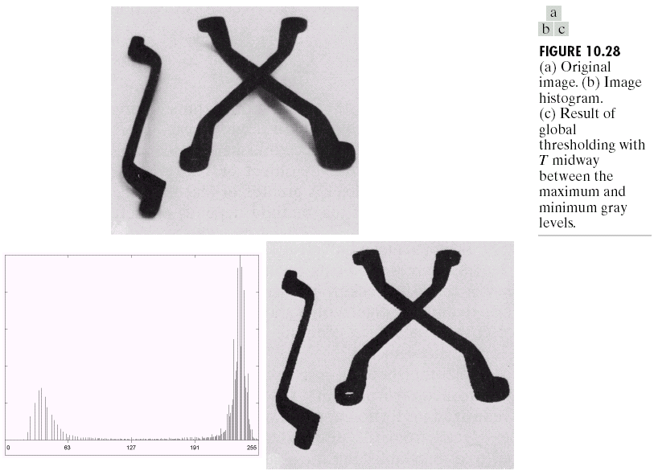
Thresholding
Basic Global Thresholding

Slide 16
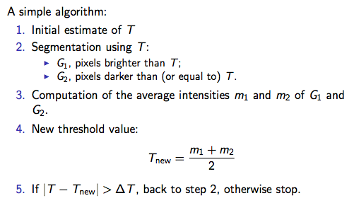
Selection of the value for T automatically

Slide 17
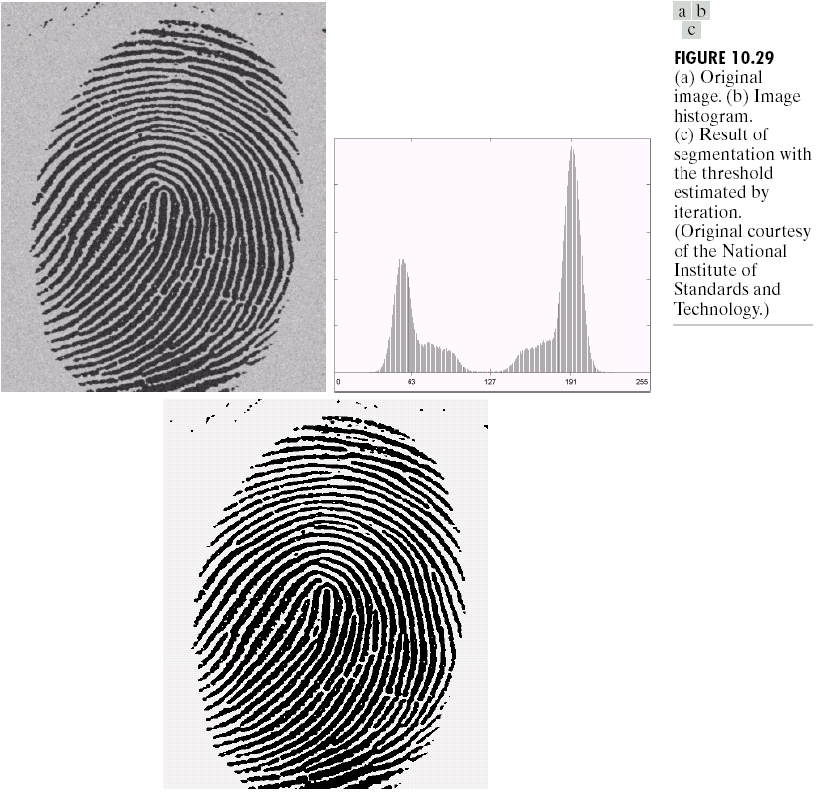
Thresholding
Basic Global Thresholding

Slide 18
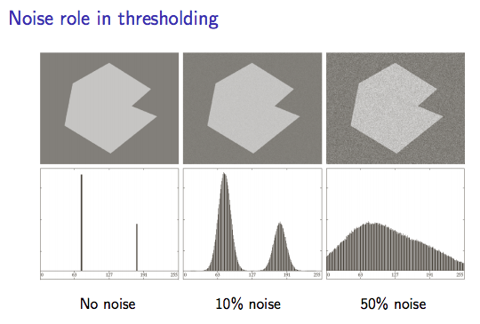

Slide 19
Global Thresholding issue

Slide 20
Basic Adaptive Thresholding
Divide original image into subimages
Utilize a different threshold to segment each subimage
If Difficulties:
Subdivision and subsequent threshold estimation

Slide 21
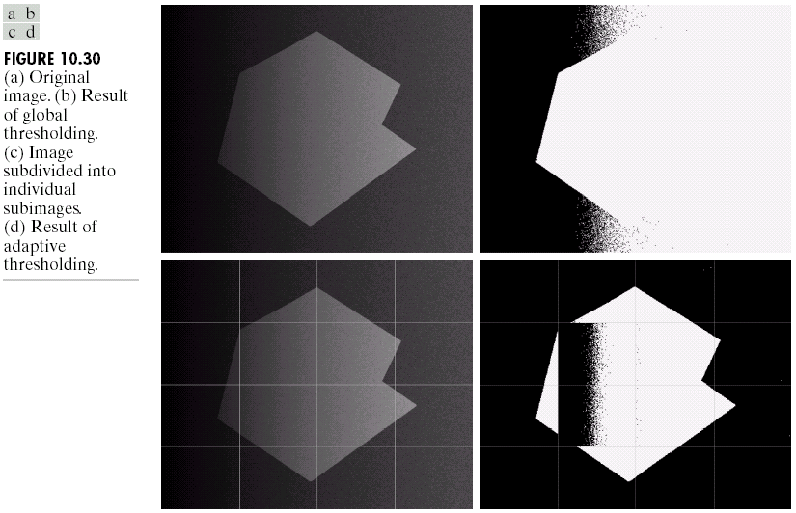
Thresholding
Basic Adaptive Thresholding
(dividing the image in sub-regions)

Slide 22
Thresholding
Basic Adaptive Thresholding
How to solve this problem?

Slide 23
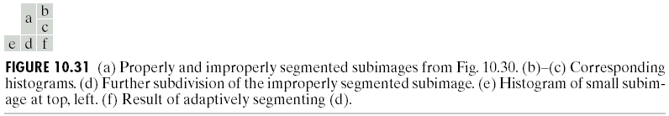
Thresholding
Basic Adaptive Thresholding
Answer: subdivision

Slide 24
Accuracy of the thresholding
The accuracy of the thresholding
The error involved in thesholding
We need some statistical property of the image where the mean error of the thresholding operation will be minimum.
Which is called optimal thresholding

Slide 25
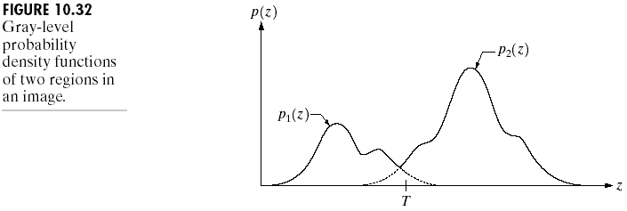
Thresholding
Optimal Global and Adaptive Thresholding
This method treats pixel values as probability density functions.
The goal of this method is to minimize the probability of misclassifying pixels as either object or background.
There are two kinds of error:
mislabeling an object pixel as background, and
mislabeling a background pixel as object.

Slide 26
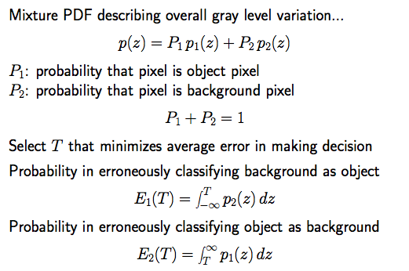

Slide 27
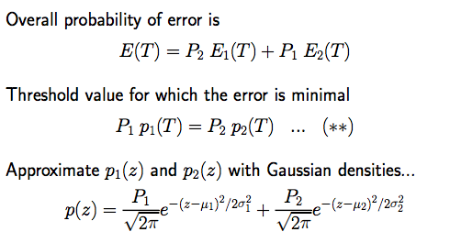

Slide 28
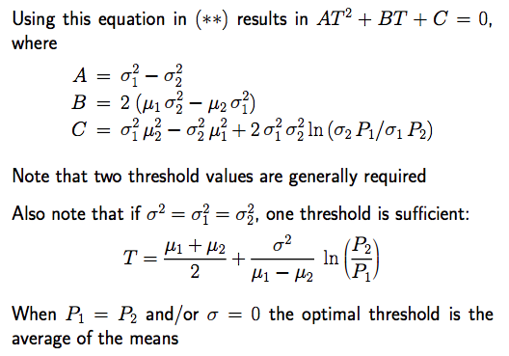

Slide 29
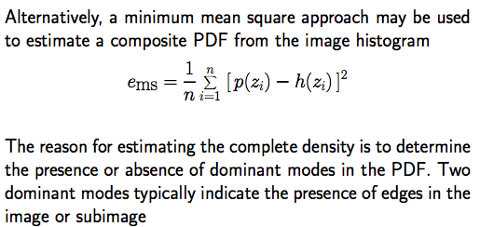

Slide 30
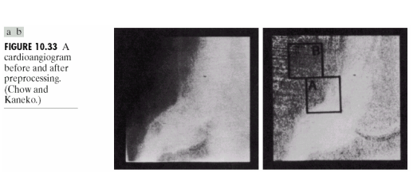
Use of optimal thresholding for image segmentation

Slide 31
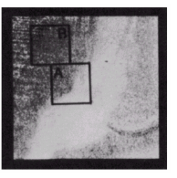
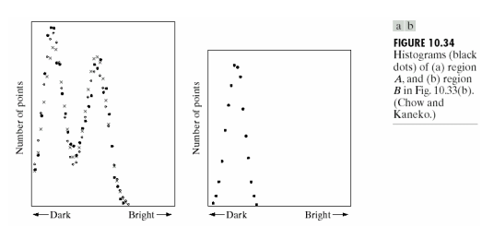

Slide 32
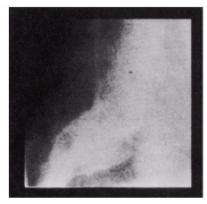
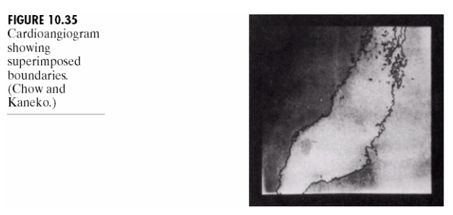

Slide 33
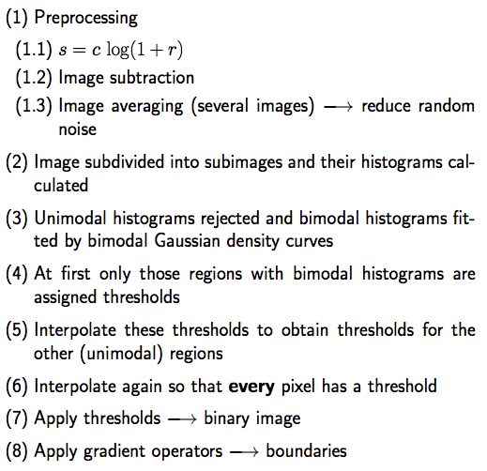

Slide 34
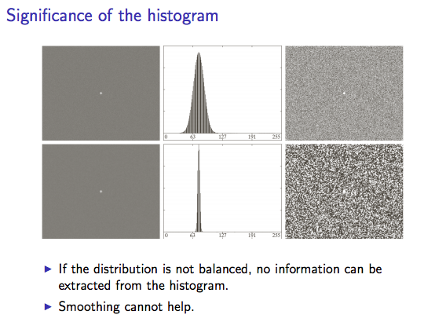

Slide 35
Local thresholding operation

Slide 36
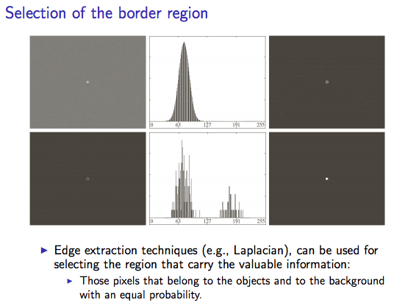

Slide 37
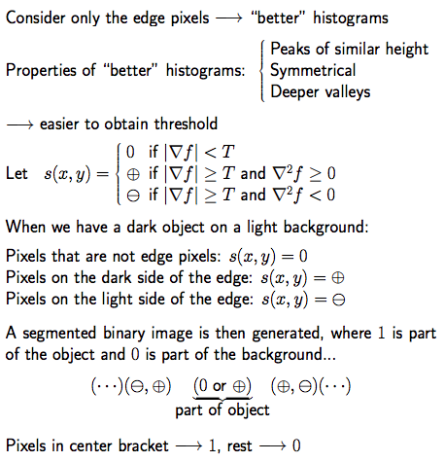

Slide 38
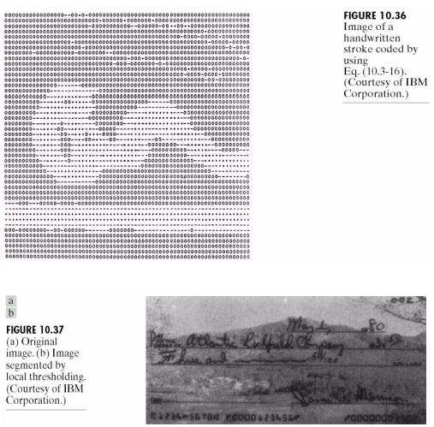

Slide 39


Slide 40
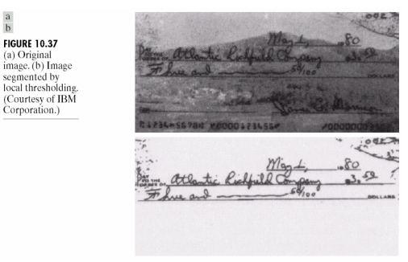

Slide 41
Summery of the lecture
Image Segmentation by thresholding
Global threshold
Adaptive/Dynamic threshold
Local threshold

Slide 42
References
Prof .P. K. Biswas Department of Electronics and Electrical Communication Engineering Indian Institute of Technology, Kharagpur
Gonzalez R. C. & Woods R.E. (2008). Digital Image Processing. Prentice Hall.
Forsyth, D. A. & Ponce, J. (2011).Computer Vision: A Modern Approach. Pearson Education.

